Slide 1
APOLOGETICS
IN ONE LESSON
almost
Ai1L.net
Lesson 24
Jesus Died by Crucifixion; His Disciples Believed He Resurrected

Slide 2
Read the non-Christian accounts of Jesus’ death by crucifixion
1

Slide 3
“...one is obliged to say, 'Here was a man. This part of the tale could not have been invented.'”
H.G. WELLS The Outline of History, Volume 1 (page 497)

Slide 4
Read the Gospels accounts of Jesus’ death by crucifixion
2

Slide 5
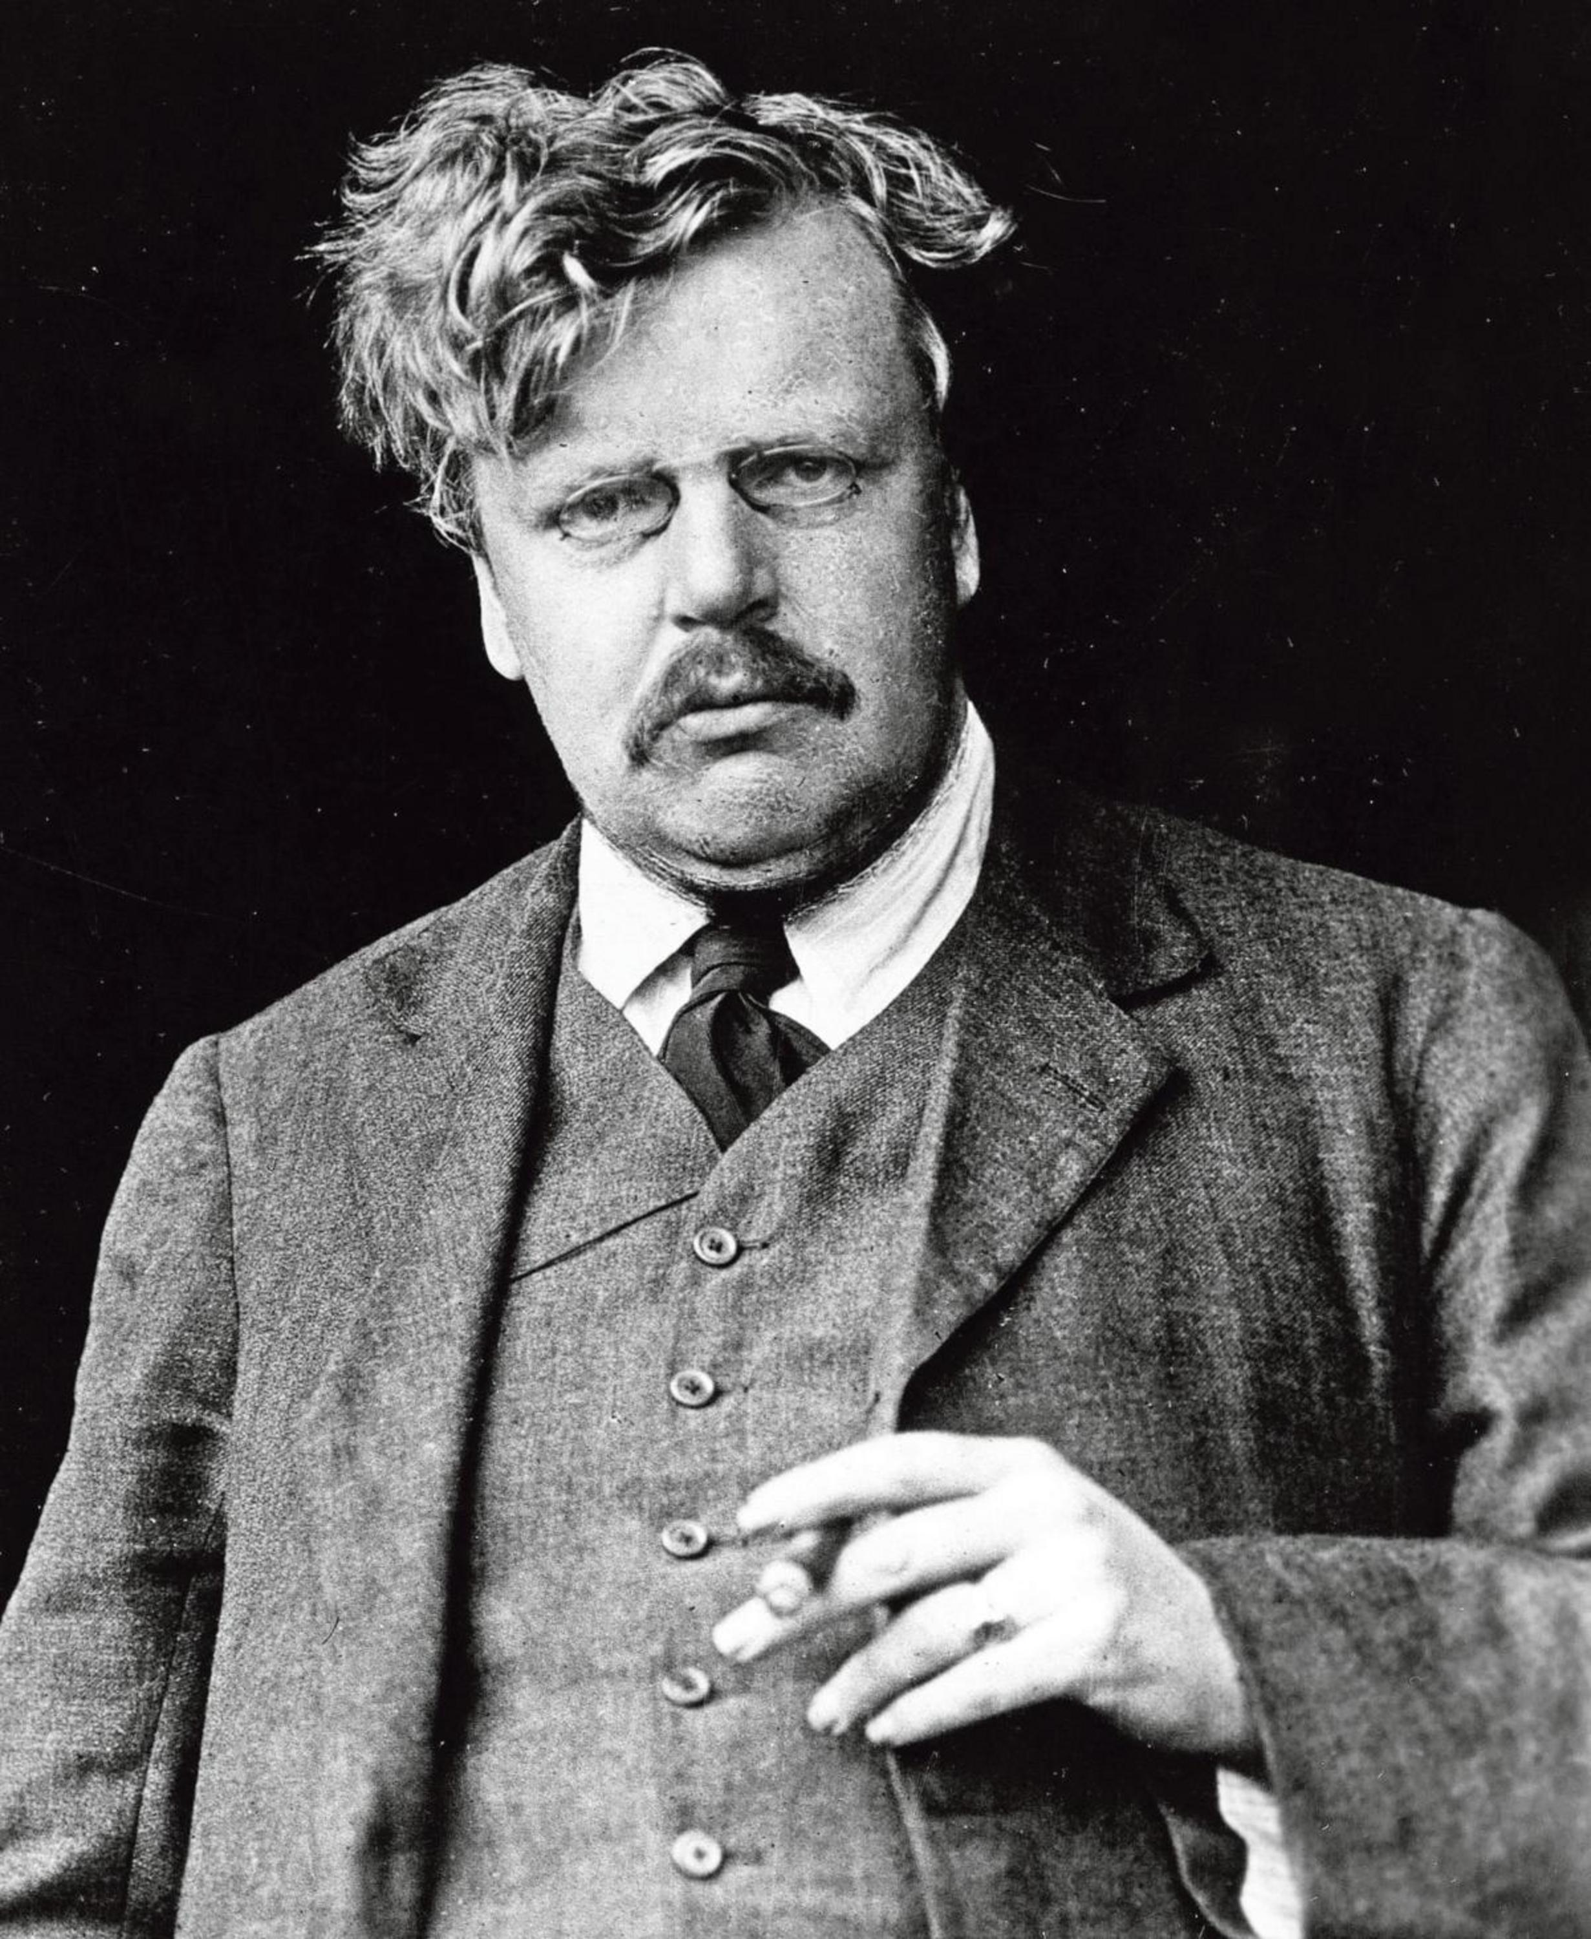
“This is the sort of truth that is hard to explain because it is a fact; but it is a fact to which we can call witnesses”
G.K. CHESTERTON The Everlasting Man

Slide 6
Document the claims of the early witnesses of Jesus’ resurrection
3

Slide 7
Which Apostles were martyred?
Peter
Paul
James, the Brother of Jesus
John, son of Zebedee
Thomas
Andrew
James, son of Zebedee
Philip
Bartholomew
Matthew
James, son of Alphaeus
Thaddeus
Simon the Zealot
Matthias
Source: “The Fate of the Apostles” by Josh McDowell
To be considered martyred, the person be killed due to being a Christian
This list includes those that are not specifically part of the Twelve (like James)

Slide 8
Which Apostles were martyred?
Peter
Paul
James, the Brother of Jesus
John, son of Zebedee
Thomas
Andrew
James, son of Zebedee
Philip
Bartholomew
Matthew
James, son of Alphaeus
Thaddeus
Simon the Zealot
Matthias
Source: “The Fate of the Apostles” by Josh McDowell
To be considered martyred, the person be killed due to being a Christian
This list includes those that are not specifically part of the Twelve (like James)

Slide 9
 | Peter
Death | Likely by crucifixion, probably by Nero
Confidence | Highest possible confidence
Sources | John 21:18–19 1 Clement 5:4–5 Ignatius Tertullian | Dionysius of Corinth Ascension of Isaiah* The Acts of Peter* Apocalypse of Peter*
 | No competing traditions
Other Details | Likely visited Rome Possibly crucified upside down
﻿* pseudepigraphal (authorship falsely attributed)

Slide 10
“Jesus said this to indicate the kind of death by which Peter would glorify God. Then he said to him, ’Follow me!’”
John 21:19

Slide 11
 | Paul
Death | Beheading by Nero
Confidence | Highest possible confidence
Sources | 2 Tim 4:6-8 Acts 19:21-28:31 1 Clement Ignatius | Dionysius of Corinth Irenaeus Tertullian
 | No competing traditions
Other Details | Highly likely to have visited Rome

Slide 12
 | James (brother of Jesus)
Death | Stoning, 62 AD
Confidence | Very probably true
Sources | Josephus Hegesippus | Clement of Alexandria Second Apocalypse of James*
 | No competing traditions
Other Details | Thrown from the Temple
﻿* pseudepigraphal (authorship falsely attributed)

Slide 13
 | John (son of Zebedee)
Death | Not likely by martyrdom
Confidence | Improbably by martyrdom
Sources | Acts of John Polycrates Irenaeus | Pseudo-Hippolytus* Eusebius Clement of Alexandria
Other Details | Likely ministered in Ephesus
﻿* probably pseudepigraphal (authorship falsely attributed)

Slide 14
 | Thomas
Death | Executed in India
Confidence | More probable than not
Sources | Early church fathers St. Thomas Christians traditions The Acts of Thomas*
 | No competing traditions
Other Details | Traveled to India (more probably than not)
﻿* pseudepigraphal (authorship falsely attributed)

Slide 15
 | Andrew
Death | Died 65-69 AD
Confidence | More plausible than not
Sources | Peter Chrysologus The Acts of Andrew* | Traditions in the East and West
 | No competing traditions
Other Details | Traveled to Greece (more probable than not)
﻿* pseudepigraphal (authorship falsely attributed)

Slide 16
 | James (son of Zebedee)
Death | Killed by Herod Agrippa I in Jerusalem
Confidence | Highest possible confidence
Sources | Acts 12:1-2 Papias Clement of Alexandria | Chrysostom Gregory of Nyssa Philip of Side
 | No competing traditions

Slide 17
“﻿not a shred of evidence exists that any apostle wavered in or recanted his faith—excluding Judas.”
SEAN MCDOWELL The Fate of the Apostles (page 261)

Slide 18
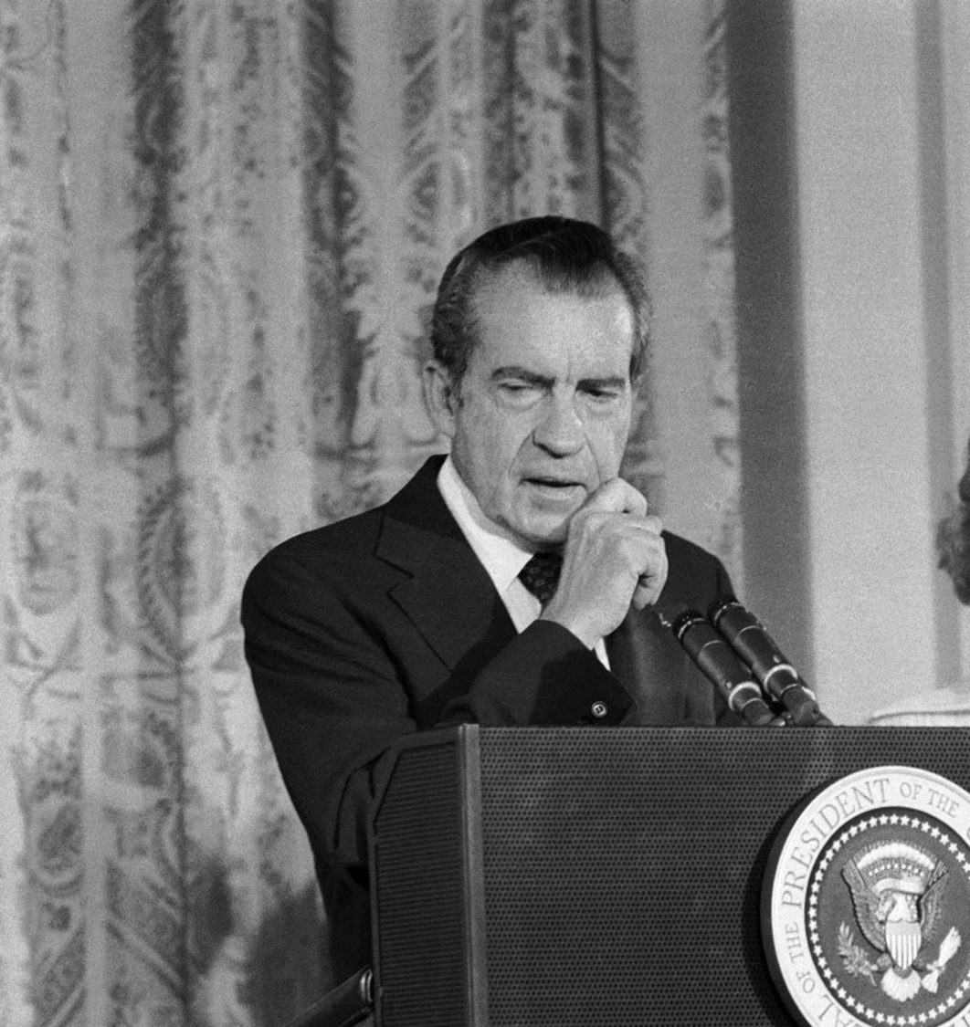
“The real cover-up, the lie, could only be held together for two weeks”
CHUCK COLSON (former Nixon Aide) Breakpoint with Chuck Colson, 2002/03/29

Slide 19
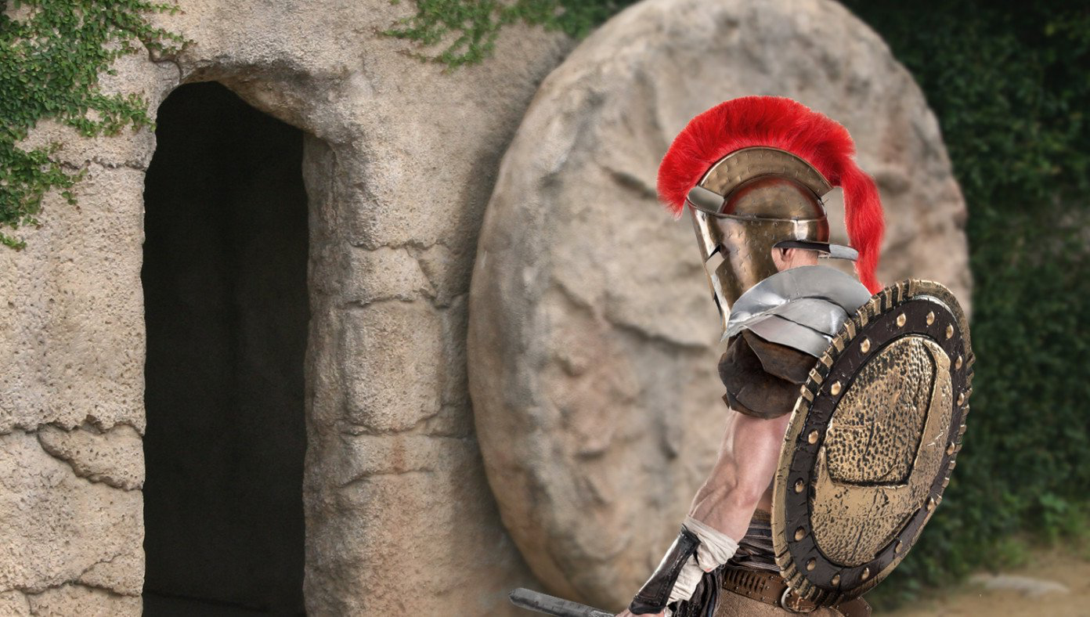
Roman Authorities Investigating Jesus For Violating Stay-In-Tomb Order
BABYLON BEE April 12th, 2020 http://bit.ly/Ai1LStayInTomb

